Slide 1
Local and regional processes mediate local-scale BEF patterns
Michael Crawford
June 10, 2020
Notes:
Hi everyone, today I’m going to be discussing my work with Nadja, Katie Barry, Adam Clark, and others on a simulation model intercomparison that we’ve been working on for some time now. At the heart of this work is understanding how local and regional processes mediate local-scale BEF relationships. I know that is a lot of jargon, so let me go through and unpack all of it.

Slide 2
Biodiversity and ecosystem functioning (BEF)
Humanity endangers the diversity and functioning of natural systems more than ever before (IPBES 2019)
Function: How stocks of materials (e.g. carbon, water, nutrients) move through a system
Experiments show that random species loss has a strong, negative effect on ecosystem functioning (Tilman, Cowles, & Isbell 2014)
How do real communities differ from our experimental ones?
Notes:
Humanity endangers the diversity and functioning of natural systems more than ever before
Diversity is clear, but what is ecosystem functioning? Functioning is how the stuff inside of an ecosystem cycles through it. For example, how nutrients or water are cycled through a forest.
For the purposes of this talk, we can simplify it: As our focal ecosystem function, we’re using biomass, a proxy for carbon sequestration.
Experiments show that random species loss has a strong, negative effect on ecosystem functioning
For example, this means that as you lose species, the plant community is less effective in sequestering carbon
However, BEF experiments use highly manipulated communities.
The traditional way one of these large experiments are designed, is that you create a species pool and then generate plots with monocultures, 2, 4, and 16 species and so on, by sampling from the species pool and growing them, watching how they grow and compete
The literature indicates that communities with more species in them – i.e. more biodiverse mixtures – have higher functioning
But when you plot these graphs, you don’t usually pay attention to the initial species richness of each plot, only their realized species richness
In effect, traditional BEF experiments simulate random species loss but using only samples from the species pool, such that the identity of the species isn’t taken into account
Much contemporary BEF literature is trying to unpack how species loss in real communities differs from our experimental “random loss”

Slide 3
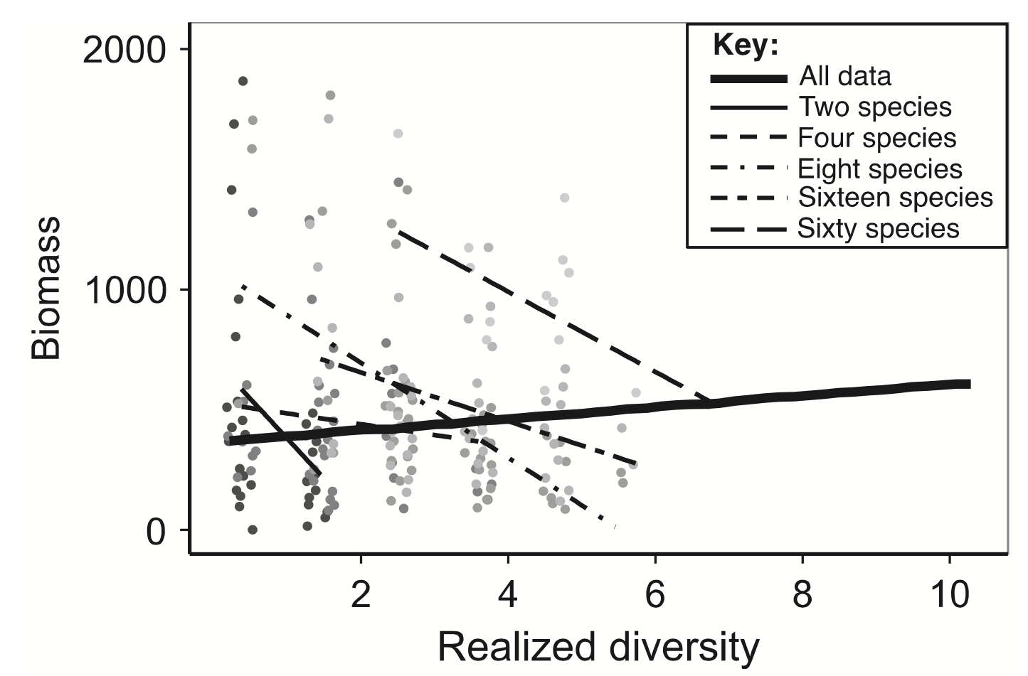
A counterintuitive pattern in BEF research
Positive BEF across richness treatments
Negative BEF within richness treatments
A site’s BEF is determined by:
Local coexistence mechanisms (Holt 2013)
Regional metacommunity processes (Leibold and Chase 2018)
In other words:
Who wins in competition, and who has access to the site
Data from the Jena Experiment, Rychtecká et al. (2014)
Plot from Leibold et al. (2017)
Notes:
Let’s take an example. Here we see data from the Jena Experiment.
Each one of these lines is a different initial species richness treatment. In other words, each plot within the experiment was seeded with this initial number of species, randomly selected from some larger species pool. A line represents each one of these treatments.
On the x-axis is realized diversity. This means how many species are actually found in the plot when they counted them.
On the y-axis is that plot’s total biomass.
The bold line here is the general response of biomass given realized diversity, this is what we generally talk about when we say that biodiversity is good. This doesn’t take into account, though, the fact that there are different initial species richness treatments.
Each one of the slimmer lines represents a regression on the data within that treatment level.
So the counterintuitive finding is that, although diversity is beneficial across the entire landscape of the BEF plots, within each realized community, it tends to be the case that plots with fewer species actually produce the most biomass!
How could this be? Well, a site’s BEF is determined by:
Local coexistence mechanisms determining which species can coexist
This means how the plants actually compete for and utilized the resources around them. What is the competitive structure of the community? For example, within a plot’s abiotic environment, are plants that tend to be bigger usually more competitive than small plants?
And regional metacommunity processes, for example seed dispersal, deciding who can recolonize vs. who is lost permanently
So, in other words Who wins in competition, and who has access to the site

Slide 4
Understanding this counterintuitive pattern
Here, we try to understand what conditions in these two processes generate this general crosshatching pattern
We hypothesize:
These patterns emerge when a species’ competitiveness in mixture is correlated to its biomass in monoculture
Metacommunity processes (seed dispersal) will mediate these relationships
Data from the Jena Experiment, Rychtecká et al. (2014)
Graph from Leibold et al. (2017)
Notes:
Here, we try to understand what conditions in these two processes generate this general crosshatching pattern
Specifically, we hypothesize that:
In a metacommunity, species may be locally adapted to conditions within a given patch.
Thus, due to heterogeneity across a landscape, the identity of the best-adapted species potentially varies from patch to patch.
Across the meta-community, this overall diversity of “best-performing species” may be positively related to ecosystem functioning.
But, within a given patch, biodiversity may be inversely related to functioning if the most locally adapted species contribute the most to ecosystem functioning, but outcompete the other species.
i.e., when the well-adapted species has access to the site, it will outcompete the other species and increase functioning
Within such communities, it is possible that seed dispersal from the meta-community may dampen this negative relationship, as the most locally adapted species are unable to fully dominate the site and thus maximize functioning.
Although we explore these metacommunity processes more in the analysis, for the purposes of this talk I’m excluding any influence from the “metacommunity”

Slide 5
Our model intercomparison
Traditional BEF experiment with six plant community assembly models
3 grasslands (May et al. 2009, Turnbull et al. 2013, Clark et al. 2017)
2 tropical forests (Maréchaux et al. 2018, Rüger et al. 2020)
1 succulent community (Reineking et al. 2006)
Different species richness treatments (monocultures, 2, 4, …, 64)
Seed the initial community, and then let competition run its course
When then compare how these simulated BEF experiments look
Notes:
To study this, we in effect run a traditional BEF experiment – mirroring the one before – with six plant community models.
They cover three types of plant communities, that all generate datasets with have realistic diversity patterns.
Within each, we design a virtual BEF experiment, generating different plots with different initial richness levels, and then let them sit and grow for a set amount of time.
We then compare all of our datasets together, to see if there are unifying mechanisms underlying their emergent patterns.

Slide 6
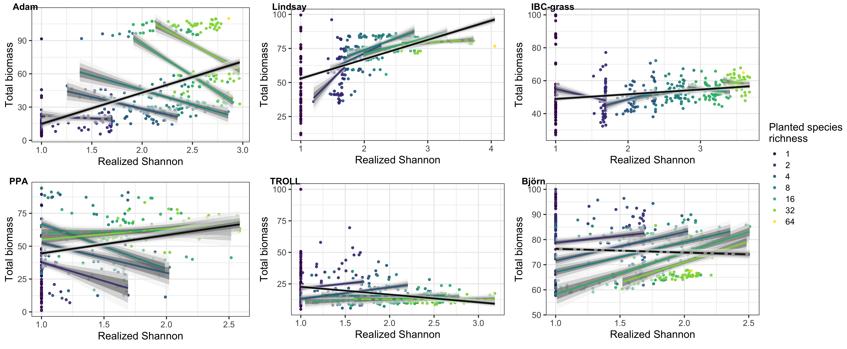
Diversity’s effect on Biomass
Notes:
So here are the results of our simulated BEF experiment. Each one of these facets is a different simulation, there are six.
The color of each point (and line) is a different initial species richness treatment.
The bold line is that overall relationship between diversity and biomass, while the colored lines are those crosshatching lines in the original graph, the different species richness treatments.
We first see that there is a great diversity of patterns! Let’s look more closely at a couple of similarities and differences between them.
Pattern similar to Leibold in Adam and PPA: Positive biodiversity-biomass relationship overall, but negative within-treatment slopes.
Adam is a model of nutrient poor prairie in Minnesota, USA.
PPA is the model that Nadja works with, studying tropical forest communities.
In Lindsay, another grassland model, we see a positive general trend, but also positive, saturating relationships within the richness treatments.
In IBC-grass, we see a slight positive general trend, but varying within-treatment slopes
In TROLL and Björn, we see the exact opposite effects!
In TROLL for example, overall diversity decreases biomass, and the individual richness treatments slowly decrease in their slopes until they are insignificant.
We suggest that a key mechanism underlying this diverse array of behavior is the correlation between species’ biomass in monoculture and their biomass in mixture.
If a species has a high biomass in monoculture and performs well in mixture, it will tend to dominate the community and increase the total biomass. However,
When the most competitive species do not perform well in monoculture, they will dominate the community but leave it in a low-biomass state.
First, we inspect the patterns of correlation between monoculture and mixture biomass. To see how they look.

Slide 7
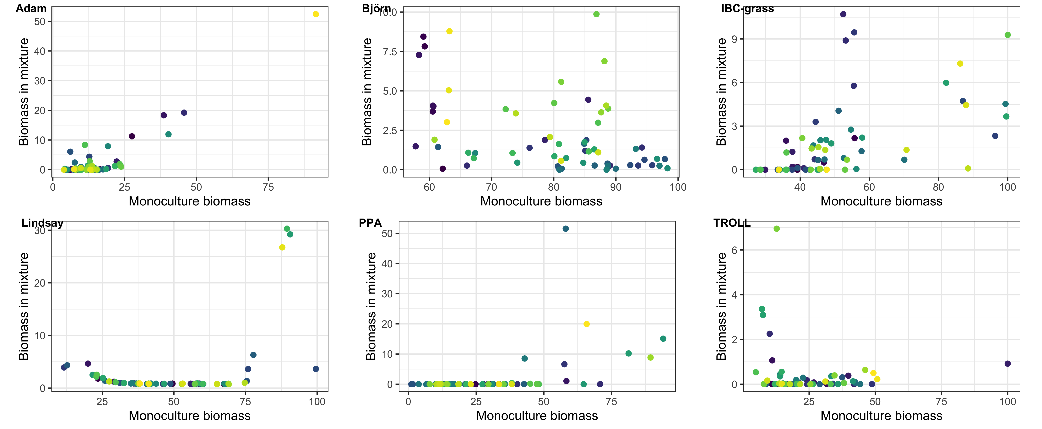
Correlations of monoculture to mixture biomass
Do the most competitive species also produce the most ecosystem functioning (biomass)?
Notes:
All the simulations have different correlations between their monoculture and mixture biomasses. Adam’s, by design, is very strongly correlated. The largest species has by far the most biomass in monoculture. In TROLL, you can see that a low monoculture-biomass species is actually the most competitive, and comes to dominate the community. Though more messy, there are also dominant species that are quite small in Björn, too. In IBC-grass many of the most competitive species are in the middle of the continuum. PPA is definitely correlated, and in Lindsay we see that there is a bimodal distribution.
So we know that there are definitely patterns within the competitive dynamics of the different models, and the species who win in mixture are sometimes the largest ones in monoculture. Is the trend real, thought?

Slide 8
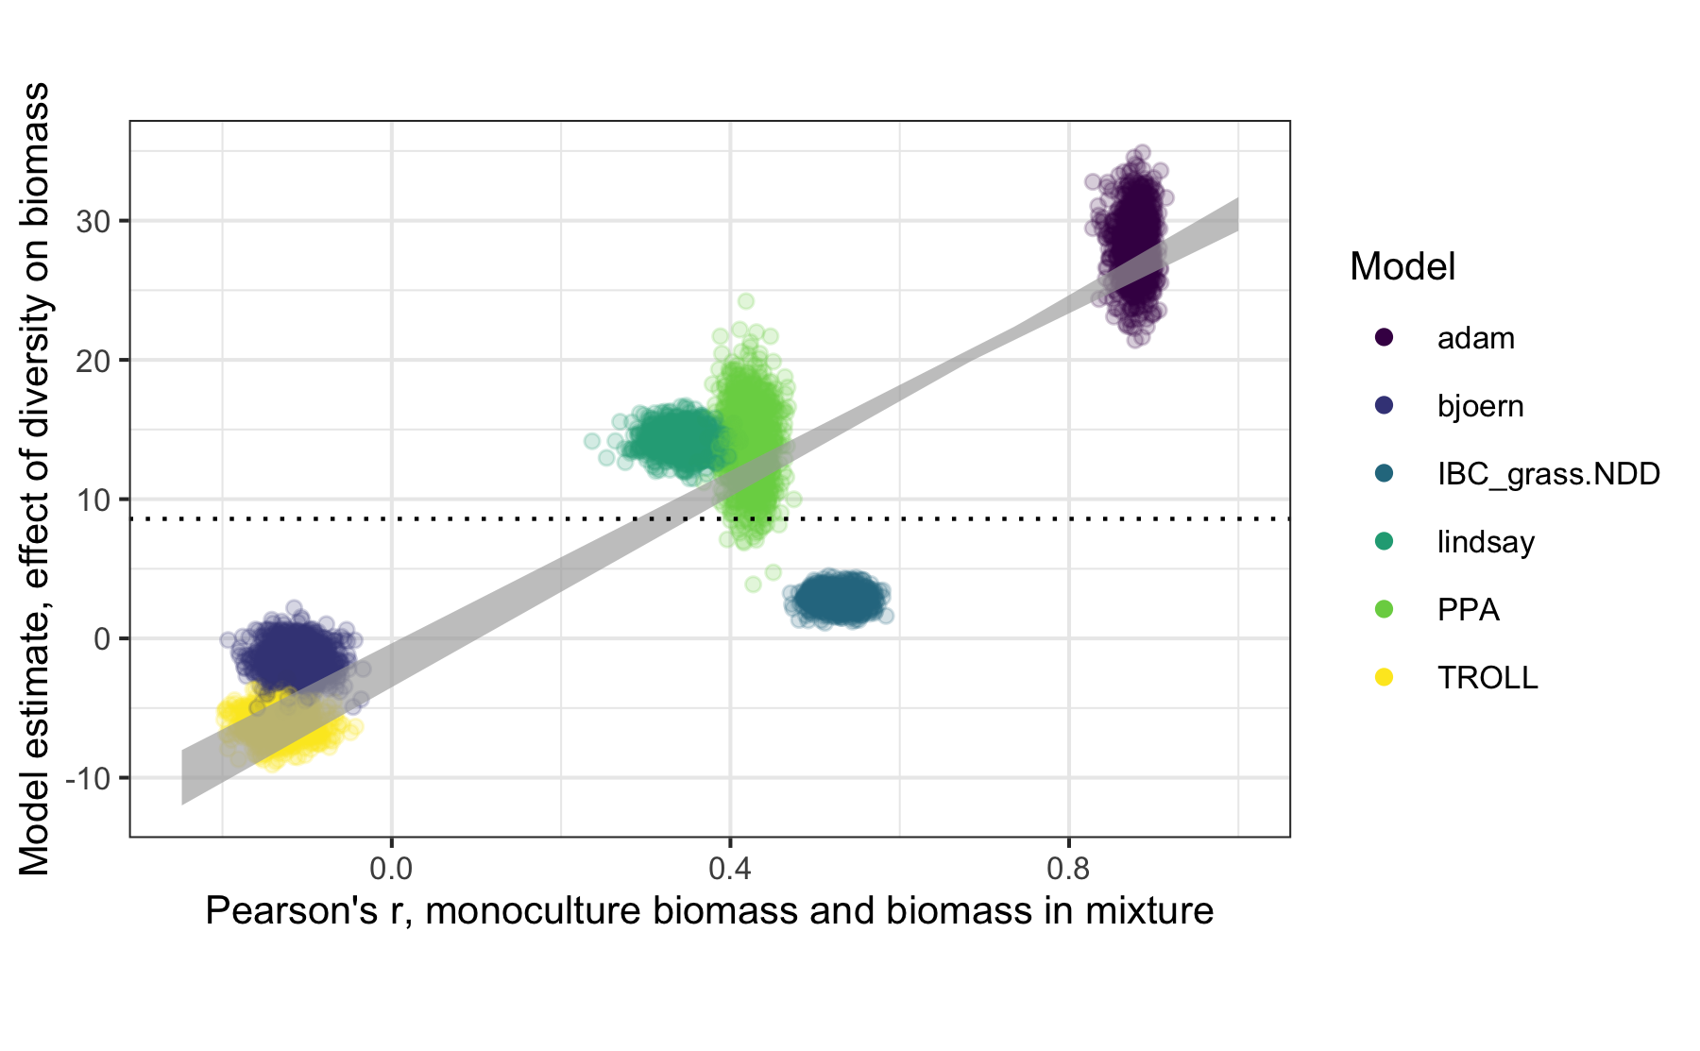
The stronger species' monoculture biomasses are correlated to their mixture biomasses (competitive strength), the stronger the selection effect across treatments, and …
Notes:
So let’s check it out.
I’m going to be light on methods here, but I’ll say that in effect, we bootstrap a new dataset that is a bunch of different “BEF experiments” from each of our original six datasets. For each BEF experiment, we calculate the Pearson’s correlation between its component species’ monoculture biomasses and their biomasses in mixture. We then regress this correlation coefficient to the estimated relationship between that community’s diversity and biomass. In other words, the y-axis is composed of all of the slope estimates for these bootstrapped BEF experiments.
Lets break it down with those two models that seemed completely opposite, Adam and TROLL.
This plot is for that bold line in the plots that I’ve been showing you, not accounting for the initial richness treatments.
The dashed line is where everything would have to sit for there to be no effect of this correlation on the emergent BEF patterns in our simulations.
On one side we have Adam. His model had that really tight correlation between biomass in monoculture and competitiveness in mixture. We see this same effect here. His overall correlation is the highest, but also his estimate.
On the other side we have TROLL, in yellow. That was the simulation that gets completely taken over by one small species. We see here that they had very little correlation, and also negative main slopes.

Slide 9
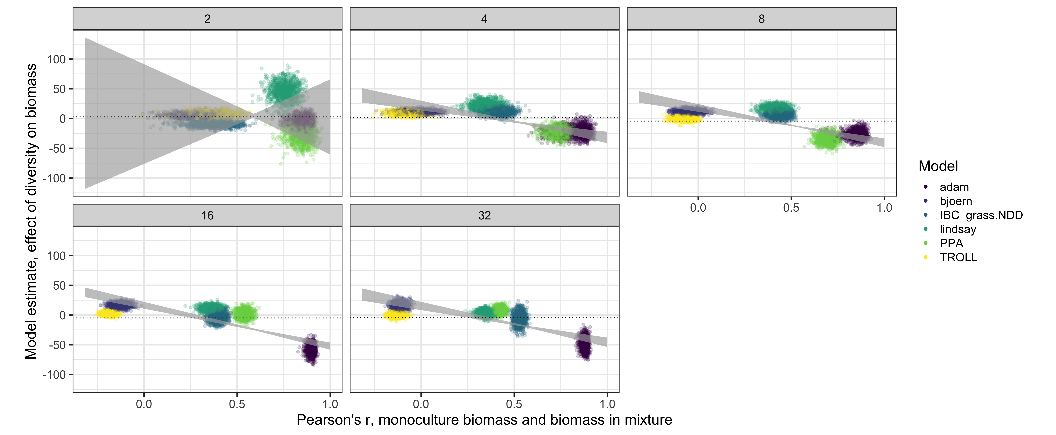
… the more negative the within-treatment relationships (competitive exclusion of low-biomass species)
Notes:
However, when you look at the treatment effects, the opposite is the case.
Each facet here is one of the initial richness treatments.
Again, focusing on our two polar-opposite models.
With Adam, we see that his again has by far the most correlation between biomass in monoculture and mixture, and that the within-treatment slopes are actually the most negative.
In other words, when these competitive species are – by chance – included in the mixture
they will dramatically increase the plot’s total biomass,
but also reduce the plots total biodiversity.
Within TROLL, we see that there is little correlation between the species’ biomass in monoculture and their competitiveness in mixture
And there is no effect of diversity within the treatments on their total biomass.

Slide 10
Discussion
The relationship between biodiversity and ecosystem function is multidimensional and scale dependent
Many patterns can emerge, and these will depend on the community-dependent relationship between the species’ effect on functioning and their competitive ability
Model intercomparison is a powerful tool to understand these complexities!
Notes:
The relationship between biodiversity and ecosystem function is multidimensional and scale dependent.
Many patterns can emerge, mediated by the community-dependent relationship between the species’ effect on functioning – their biomass in monoculture, for example – and their competitive ability in mixture – that is, their mixture biomass.
We find that within a community in which the most competitive species in mixture are also those that produce the most biomass, this crosshatched pattern will emerge.
Within a community in which the most competitive species in mixture is one of the lowest-biomass producing species, a very different pattern emerges.
Finally, of course, model intercomparison is a powerful tool to explore these complexities!

